Slide 1




Perceptually Fluent Features of Study Words Do Not Inflate Judgments of Learning: Evidence from Font Size, Highlights, and Sans Forgetica Font Type.
Nicholas P. Maxwell, Trevor Perry, & Mark J. Huff
nicholas.maxwell@usm.edu | https://osf.io/3xwdr/
Abstract 2416

Slide 2
Introduction
Maxwell Abstract 2416
Judgments of learning (JOLs) are commonly used to assess metacognitive processes.
Rhodes & Castel (2008)
Font-Size Effect
JOLs are increased for large vs small font
Metacognitive Illusion - No differences to recall
Goal: Replicate Rhodes & Castel (2008) while extending to other perceptual manipulations
Highlighting
Sans Forgetica

Slide 3
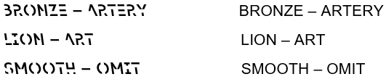
Overview of Experiments
Maxwell Abstract 2416
Experiment 1 – Font-Size (n = 41) vs. Highlighting (n = 41) vs. Control (n = 39)
54-pt. vs. 12-pt./32-pt. Yellow Highlight vs. 32-pt Arial/32-pt. Arial
related vs unrelated pairs
Experiment 2 – Font-Size (n = 36) vs Highlighting (n = 40) vs Control (n = 32)
unrelated pairs only
Experiment 3 – Sans Forgetica (n = 39) vs Control (n = 41)
Unrelated pairs only
32-pt. Sans Forgetica vs. 32-pt. Arial/32-pt. Arial
credit-card credit-card
credit-card credit-card
credit-card credit-card

Slide 4
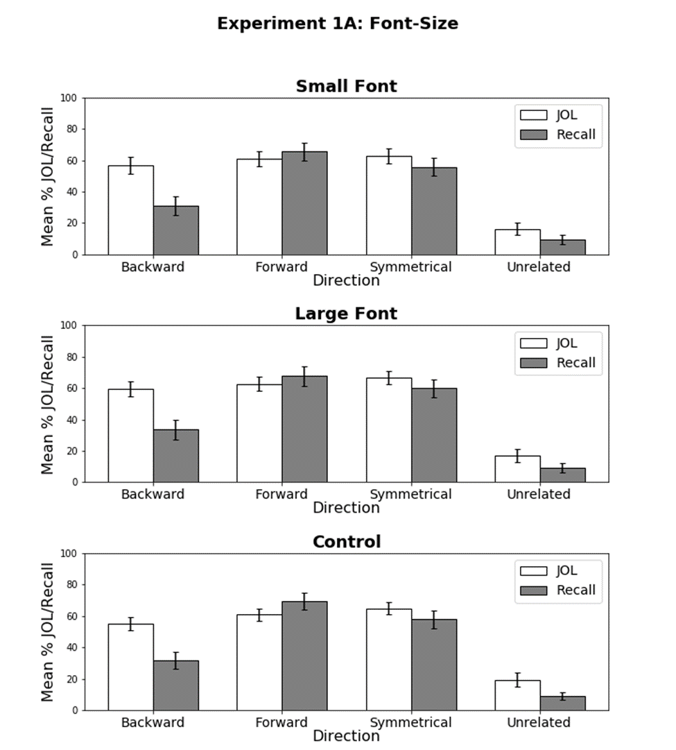
Results – Experiment 1 (Font-Size)
Maxwell Abstract 2416
Large vs. Small
Large font produced greater JOLs/recall relative to small, F(1, 40) = 12.20, MSE = 66.26, η_{p}² = .23
No Interaction!
Large and Small vs. Control
No effect of font-size and no interactions, Fs < 1.47, ps > .22, p_{BIC}s > .99
*Bars indicate 95% CI
Notes:
Font-size: Main effect of of font-size, indicating that JOLs and recall were equally increased for large font.
No differences between large or small and the control group
Highlighting: No effect of highlights

Slide 5
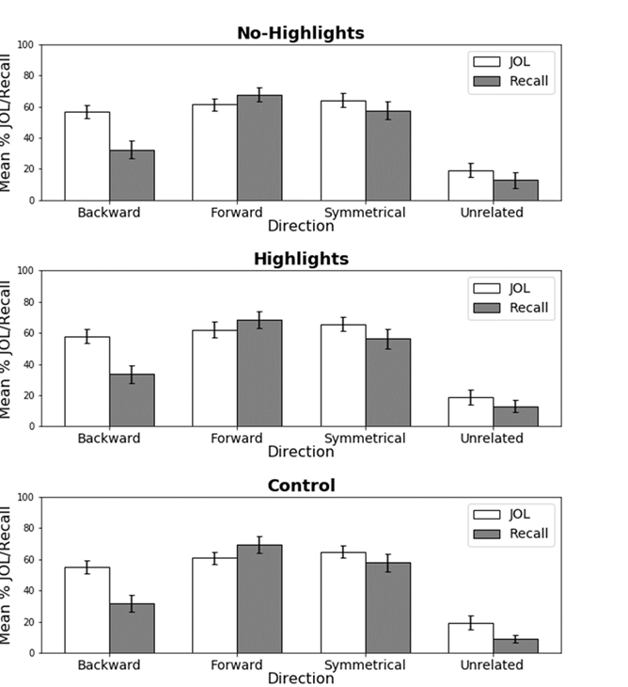
Results – Experiment 1 (Highlighting)
Maxwell Abstract 2416
Highlight vs. No-Highlight
No effect of highlighting, F < 1, p_{BIC} = .83
Highlight and No-Highlight vs. Control
No effect of Highlighting and no interactions, Fs < 1.56, ps > .19, p_{BICs} > .99.
*Bars indicate 95% CI
Notes:
Highlighting: No effect of highlights

Slide 6
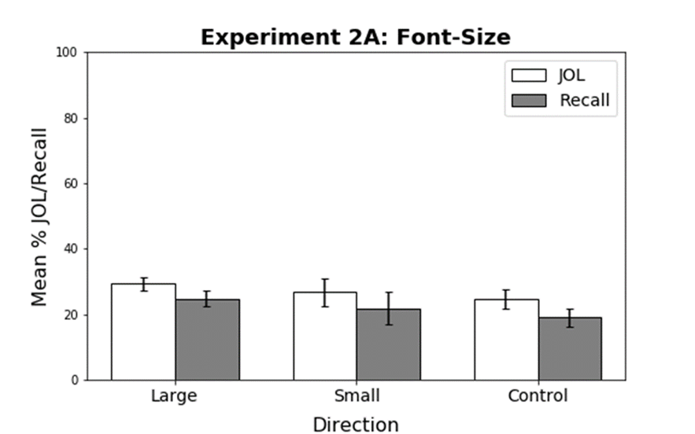
Results – Experiment 2 (Font-Size)
Maxwell Abstract 2416
Large vs. Small:
Large font produced greater JOLs/recall relative to small, F(1, 35) = 19.10, MSE = 13.76, η_{p}² = .35
Large vs. Control:
Marginal effect of font-size, F(1, 66) = 3.54, MSE = 249.20, p = .06, η_{p}² = .05, p_{BIC} = .58
Small vs. Control:
No effect of font-size, F < 1, p_{BIC} = .85
*Bars indicate 95% CI

Slide 7
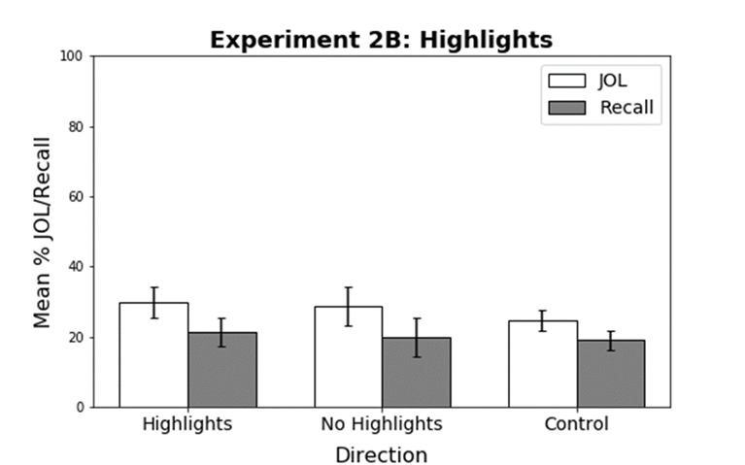
Results – Experiment 2 (Highlighting)
Maxwell Abstract 2416
Highlight vs. No-Highlight
No effect of highlighting, F(1, 36) = 2.82, MSE = 18.23, p = .10, p_{BIC} = .60
Highlight and No-Highlight vs. Control:
Fs < 1, p_{BIC}s > .85.
*Bars indicate 95% CI

Slide 8
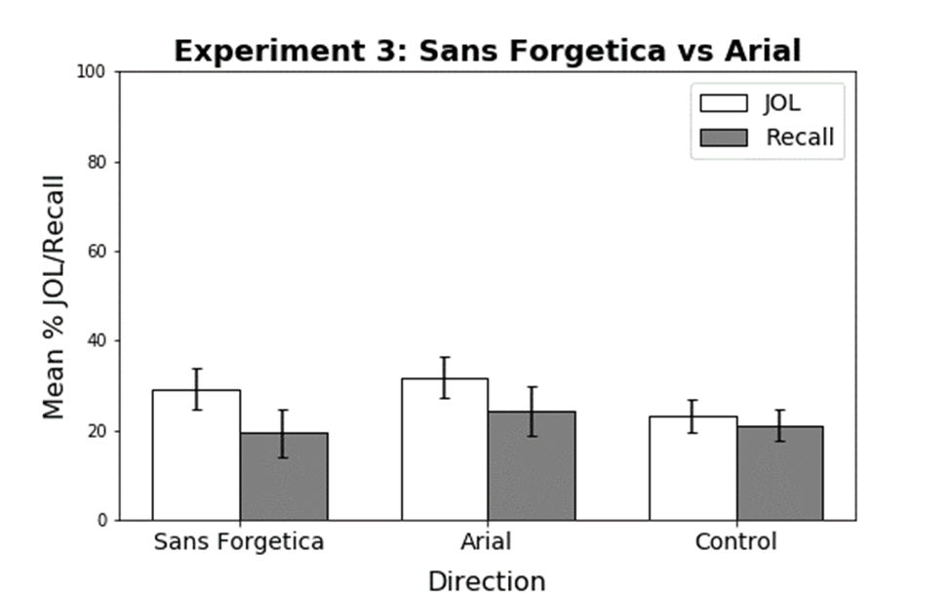
Results – Experiment 3
Maxwell Abstract 2416
SF vs. Arial:
SF produced lower JOLs/recall relative to arial, F(1, 38) = 17.77, MSE = 28.66, η_{p}² = .32
SF vs. Control:
No effect, F < 1, p_{BIC} = .86
Arial vs. Control:
JOLs/recall rates were greater for Arial font pairs than the control pairs F(1, 78) = 5.01, MSE = 271.12, η_{p}² = .06
*Bars indicate 95% CI
Notes:
Sans Forgetica did not inflate JOLs relative to Arial pairs. However, sans Forgetica produced a memory cost compared to Arial pairs. Mixed list Arial pairs received higher JOLs compared to the same pairs in the control group, suggesting participants favor more fluent fonts.

Slide 9
Conclusion
Maxwell Abstract 2416
Partially support Rhodes & Castel (2008)
Large font produces some benefit for both JOLs and recall (Ex 1 and 2)
Failed to extend to highlights (Ex 1 and 2) and Sans Forgetica (Ex 3)
Higher JOLs for Arial pairs in mixed lists suggests participants favor fluent fonts
Perceptually distinctive pairs do not seem to selectively benefit JOLs!

